Slide 1
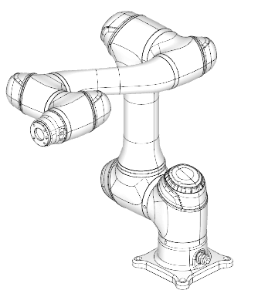
Euler Angle Rotation of COBOT End-effecter

Slide 2
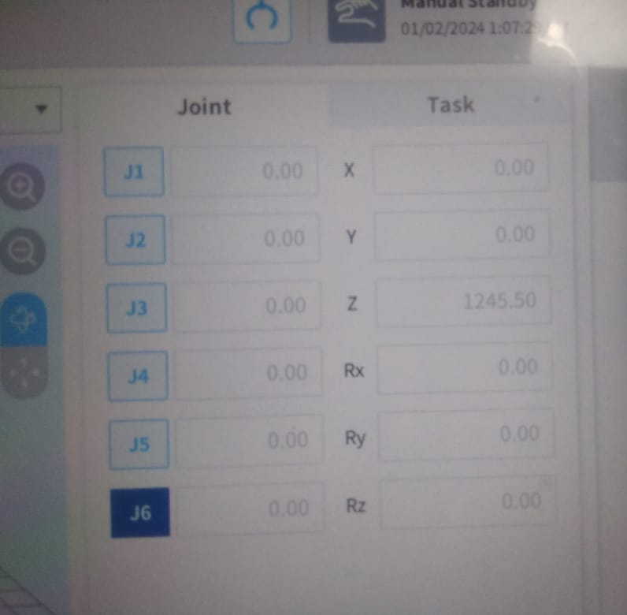
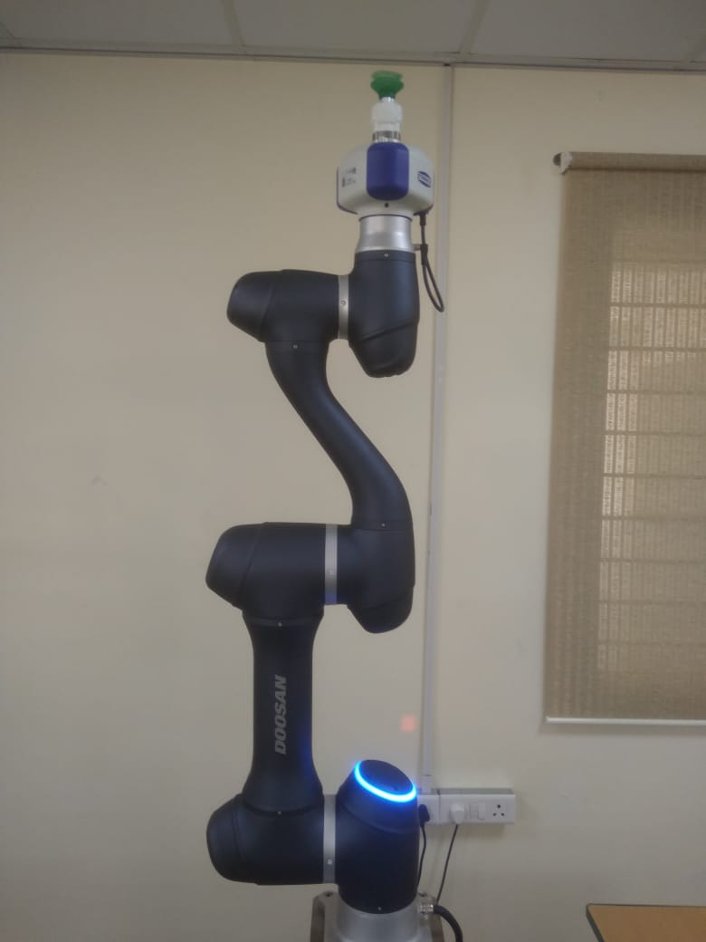
Home configuration
Z
{6}
X
Y
190
124
367
1245.5
900
409
Z
{0}
X
155.5
Y

Slide 3

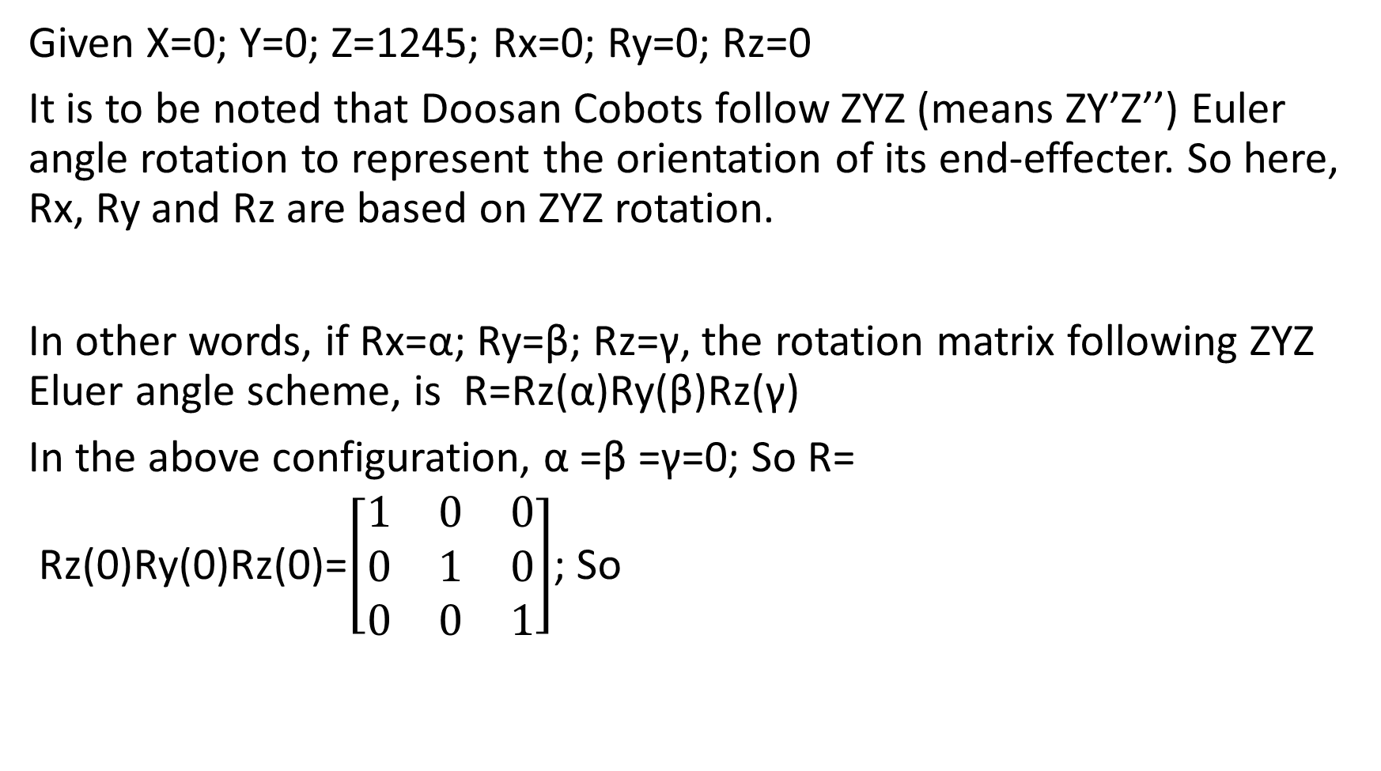
Determination of ⁰T₆
Given X=0; Y=0; Z=1245; Rx=0; Ry=0; Rz=0
It is to be noted that Doosan Cobots follow ZYZ (means ZY’Z’’) Euler angle rotation to represent the orientation of its end-effecter. So here, Rx, Ry and Rz are based on ZYZ rotation.
In other words, if Rx=α; Ry=β; Rz=γ, the rotation matrix following ZYZ Eluer angle scheme, is R=Rz(α)Ry(β)Rz(γ)
In the above configuration, α =β =γ=0; So R=
Rz(0)Ry(0)Rz(0)=$\left[\begin{matrix}1 & 0 & 0 \\ 0 & 1 & 0 \\ 0 & 0 & 1\end{matrix}\right]$; So

Slide 4
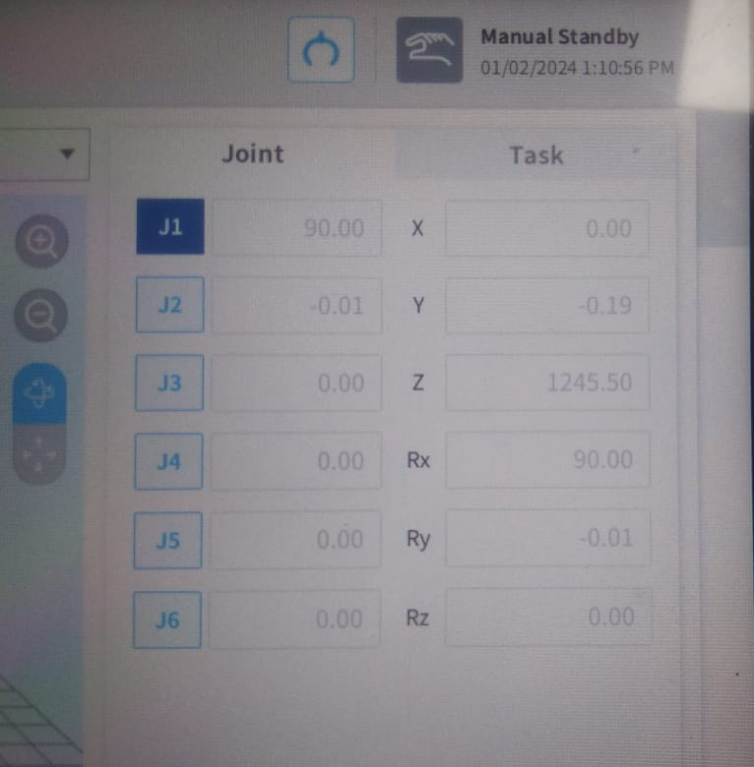
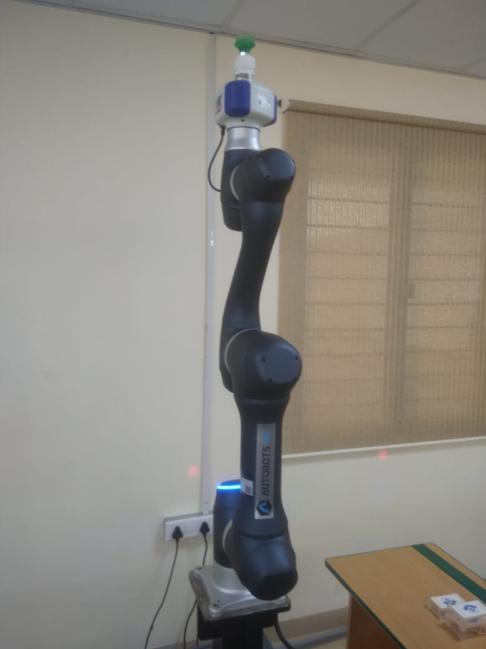
90º rotation of J1
Z
{6}
X
Y
{0}
X
Z
J1
Y

Slide 5

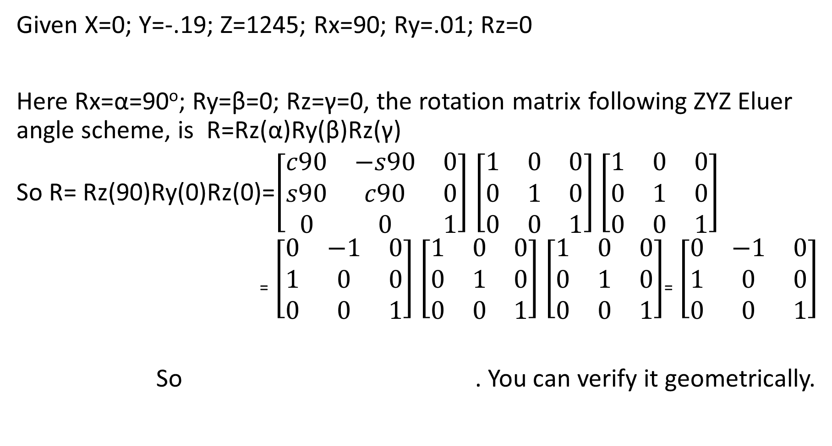
Determination of ⁰T₆
Given X=0; Y=-.19; Z=1245; Rx=90; Ry=.01; Rz=0
Here Rx=α=90º; Ry=β=0; Rz=γ=0, the rotation matrix following ZYZ Eluer angle scheme, is R=Rz(α)Ry(β)Rz(γ)
So R= Rz(90)Ry(0)Rz(0)=$\left[\begin{matrix}c90 & −s90 & 0 \\ s90 & c90 & 0 \\ 0 & 0 & 1\end{matrix}\right]$ $\left[\begin{matrix}1 & 0 & 0 \\ 0 & 1 & 0 \\ 0 & 0 & 1\end{matrix}\right]$ $\left[\begin{matrix}1 & 0 & 0 \\ 0 & 1 & 0 \\ 0 & 0 & 1\end{matrix}\right]$
₌ $\left[\begin{matrix}0 & −1 & 0 \\ 1 & 0 & 0 \\ 0 & 0 & 1\end{matrix}\right]$ $\left[\begin{matrix}1 & 0 & 0 \\ 0 & 1 & 0 \\ 0 & 0 & 1\end{matrix}\right]$ $\left[\begin{matrix}1 & 0 & 0 \\ 0 & 1 & 0 \\ 0 & 0 & 1\end{matrix}\right]$₌ $\left[\begin{matrix}0 & −1 & 0 \\ 1 & 0 & 0 \\ 0 & 0 & 1\end{matrix}\right]$
So . You can verify it geometrically.

Slide 6
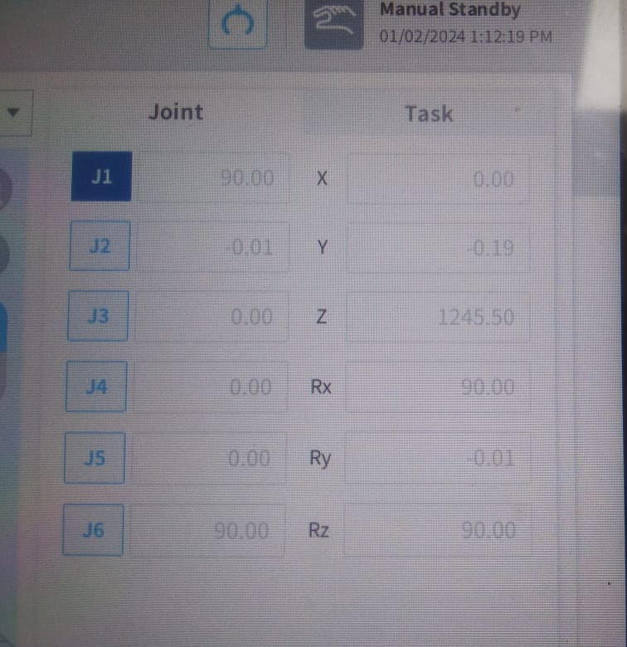
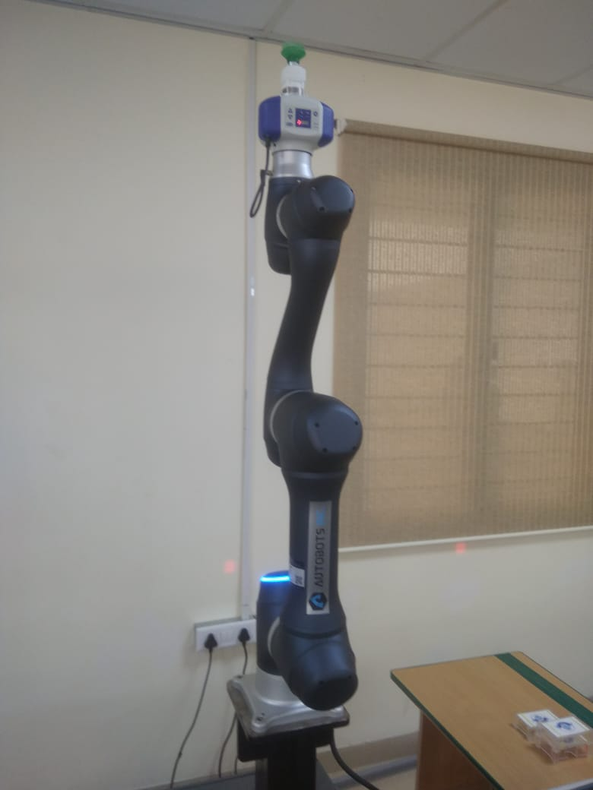
90º rotation of J6
Z
{6}
Y
X
J5
J6
J4
J3
{0}
X
Z
J1
Y
J2

Slide 7

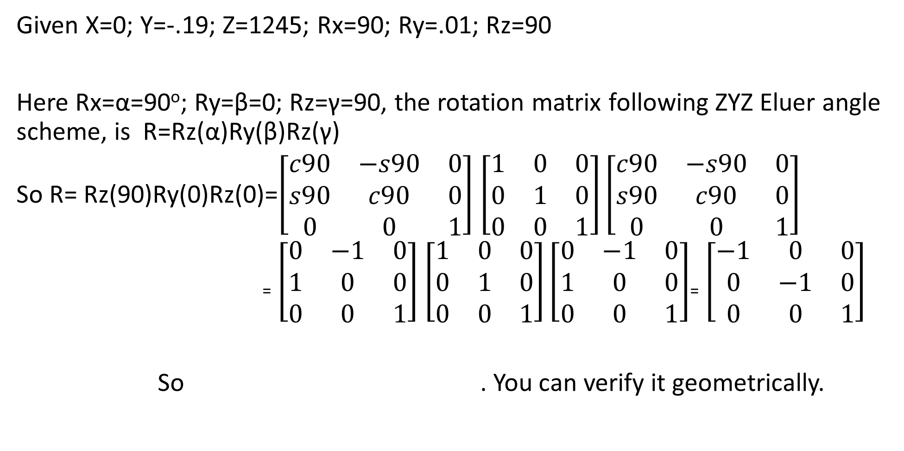
Determination of ⁰T₆
Given X=0; Y=-.19; Z=1245; Rx=90; Ry=.01; Rz=90
Here Rx=α=90º; Ry=β=0; Rz=γ=90, the rotation matrix following ZYZ Eluer angle scheme, is R=Rz(α)Ry(β)Rz(γ)
So R= Rz(90)Ry(0)Rz(0)=$\left[\begin{matrix}c90 & −s90 & 0 \\ s90 & c90 & 0 \\ 0 & 0 & 1\end{matrix}\right]$ $\left[\begin{matrix}1 & 0 & 0 \\ 0 & 1 & 0 \\ 0 & 0 & 1\end{matrix}\right]\left[\begin{matrix}c90 & −s90 & 0 \\ s90 & c90 & 0 \\ 0 & 0 & 1\end{matrix}\right]$
₌ $\left[\begin{matrix}0 & −1 & 0 \\ 1 & 0 & 0 \\ 0 & 0 & 1\end{matrix}\right]$ $\left[\begin{matrix}1 & 0 & 0 \\ 0 & 1 & 0 \\ 0 & 0 & 1\end{matrix}\right]\left[\begin{matrix}0 & −1 & 0 \\ 1 & 0 & 0 \\ 0 & 0 & 1\end{matrix}\right]$₌ $\left[\begin{matrix}−1 & 0 & 0 \\ 0 & −1 & 0 \\ 0 & 0 & 1\end{matrix}\right]$
So . You can verify it geometrically.

